Slide 1

Photon & Neutron working meeting
Giuseppe La Rocca, EGI Foundation
giuseppe.larocca@egi.eu

Slide 2
Outline
Status of the EGI Notebooks service
Access to data services with EGI Notebooks service
Integration with B2DROP
Reproducible Open science with EGI Notebooks, Zenodo and Binder
Status of the AAI integration in the PANOSC cluster project
Data archiving solutions
Open discussion

Slide 3
EGI Notebooks
Jupyter as a Service in the EGI Cloud

Slide 4
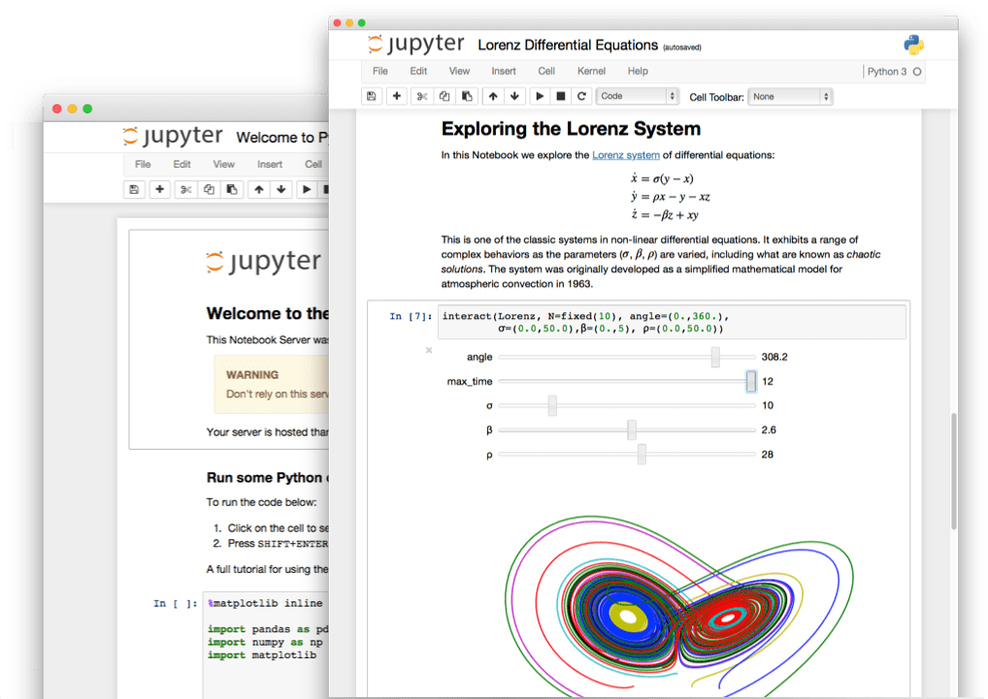


The Jupyter Notebook in a nutshell
Non-profit, open-source, interactive platform for Data Science born out of the iPython project in 2014
Released under the BSD license
Notebooks can be shared with others using email, Dropbox, GitHub
Interactive widgets

Slide 5

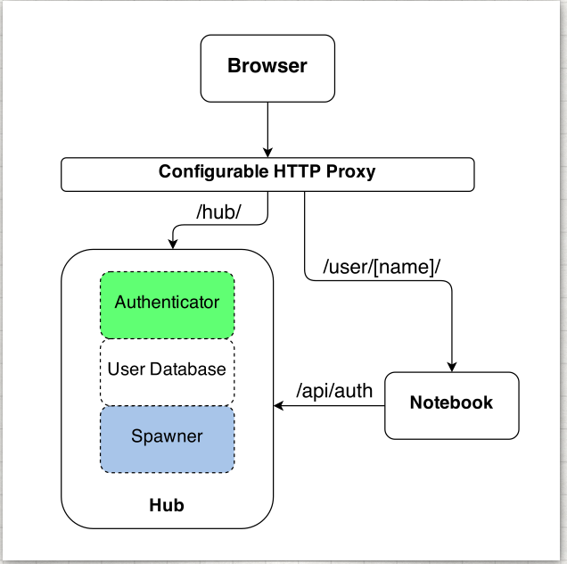
The JupyterHub project
Jupyter is single user by design
JupyterHub is a multi-user version of notebook designed for companies, classrooms and research labs
Manages Authentication
Spawns single-users notebooks servers on-demand
Gives each user a complete Jupyter server

Slide 6
The EGI Notebooks service
JupyterHub hosted in the EGI Cloud
Offers Jupyter notebooks ‘as Service’
One-click solution: login and start using
Extra EGI Features:
Login with the EGI AAI Check-In service
Persistent storage for notebooks
Bring your own environments/kernels
Use EGI computing and storage resources from your notebooks

Slide 7
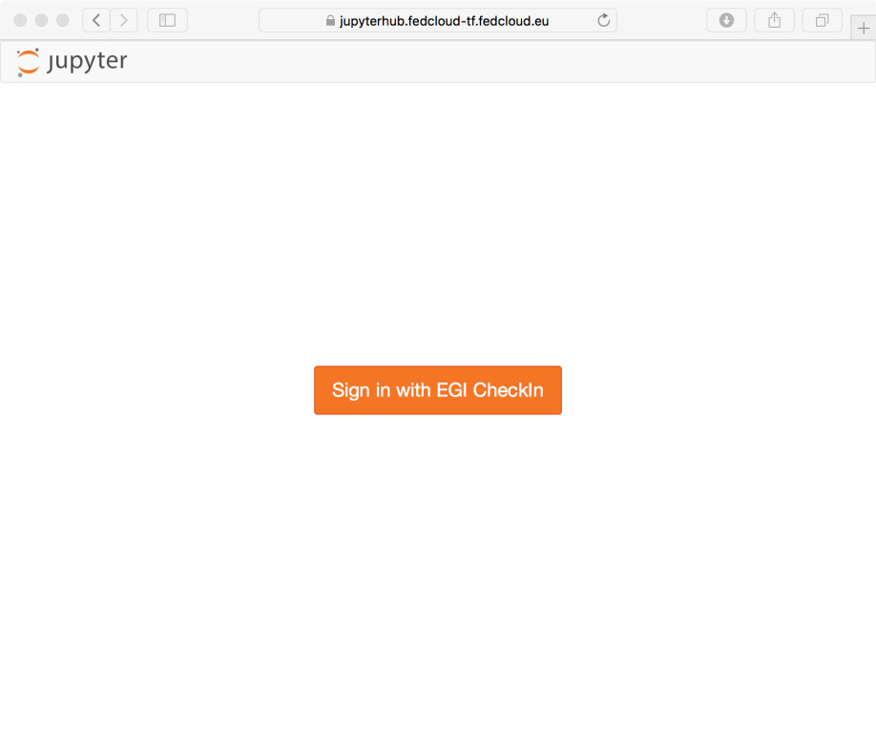
Single Sign-On (SSO)
Completely integrated with EGI Check-in
Login with eduGAIN, social (Google, Facebook, LinkedIn) or EGI SSO
Fine grained authorisation
VO membership
Role, group, …

Slide 8
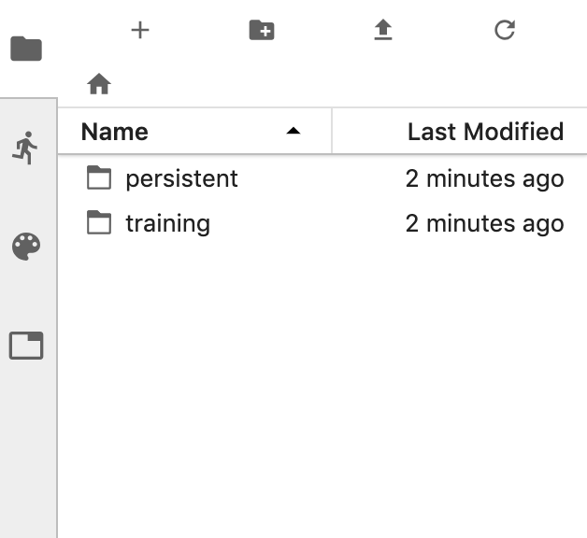
Persistency
Persistent directory linked from home
User decides what to keep
NFS storage
EGI DataHub/Onedata
Other files coming from the notebook environment

Slide 9
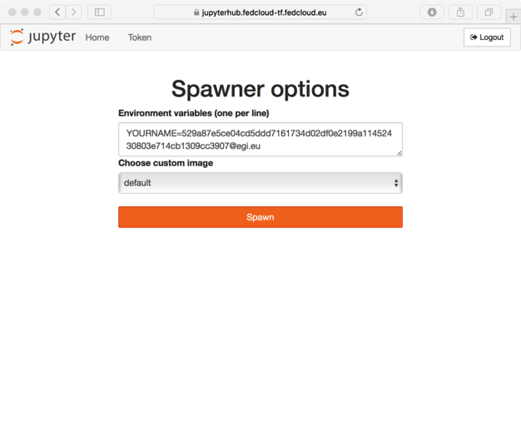
Custom environments
Easy to extend with your own notebook environment
Docker container image with JupyterHub v0.9
No root user
Uses $HOME for notebooks
User select what to start when creating their notebooks

Slide 10
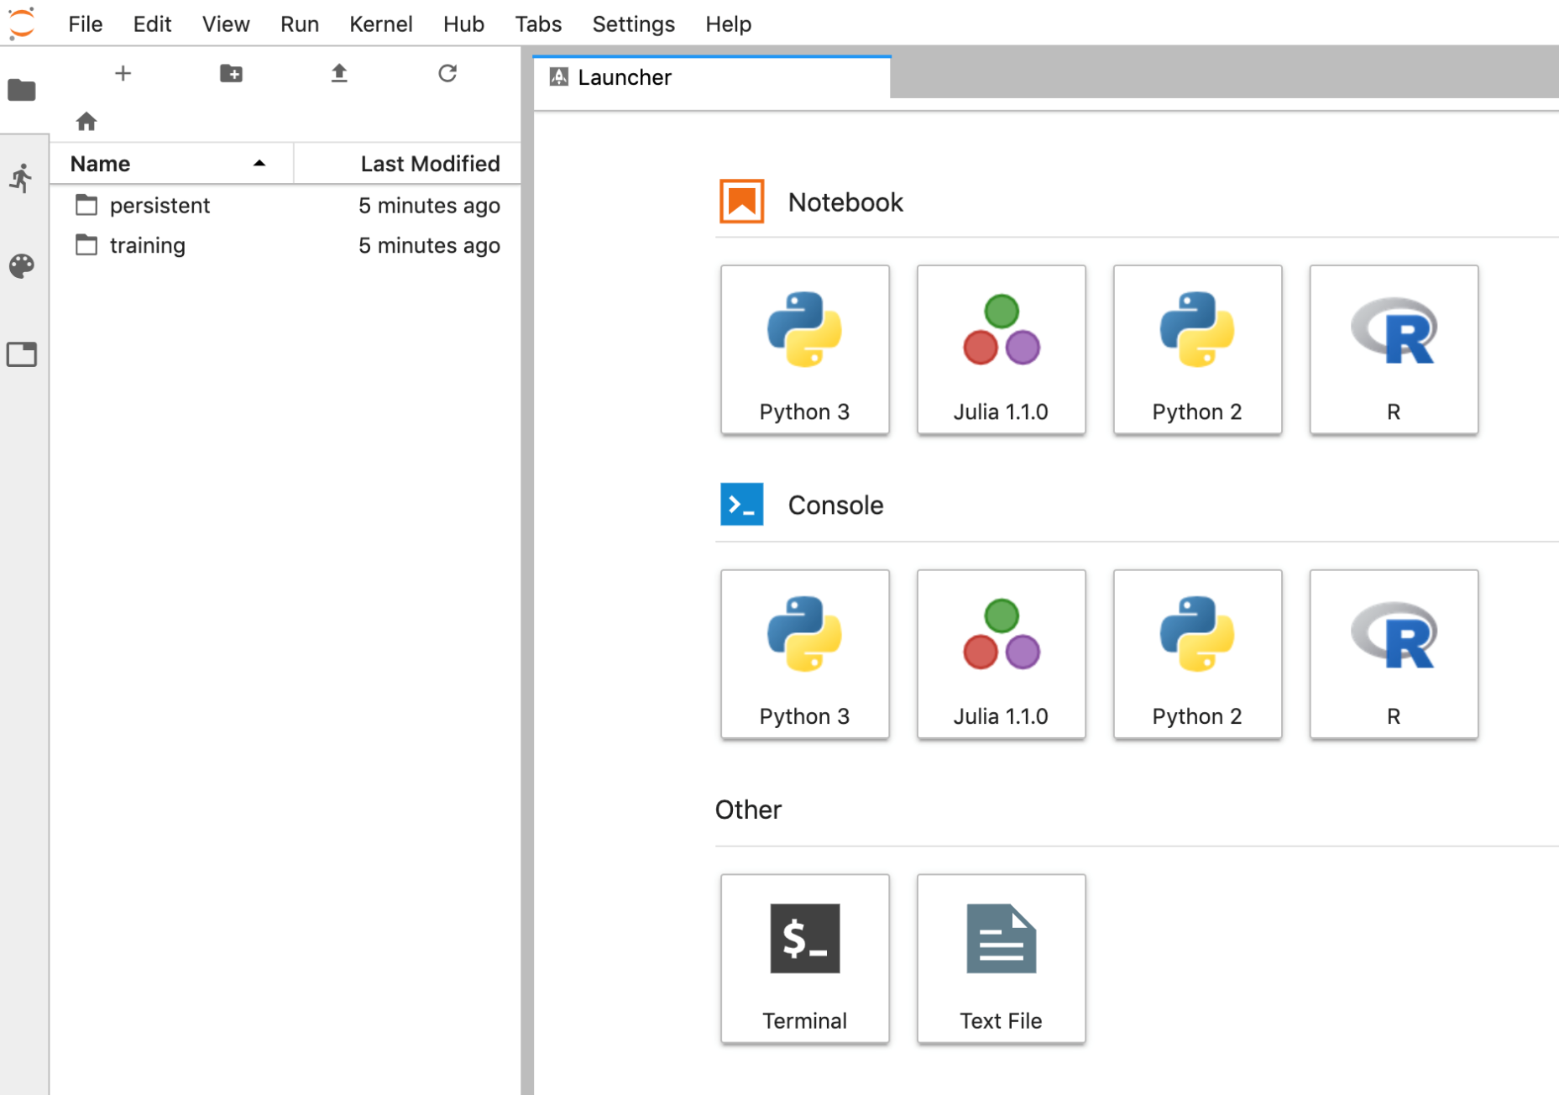
JupyterLab interface

Slide 11
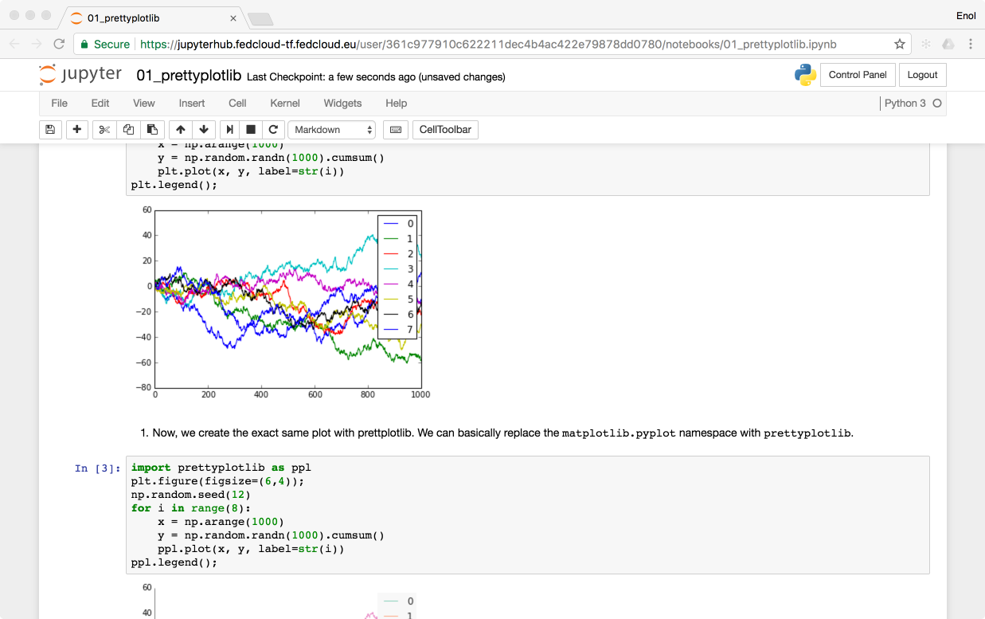


Technology Stack
https://notebooks.egi.eu
EGI CheckIn
Kubernetes cluster powered by EGI Cloud Compute
SSL Certificate
Persistent
Storage
Kubernetes
Ingress

Slide 12
Service modes
Catch-all instance
Available via the Marketplace
Limited resources: 1 CPU, 1GB RAM and 10GB of persistent storage
Sponsored access (free for the users)
Kills notebooks after 1 hour of inactivity (Use the persistent folder → Don’t loose your work!)
VO/Community deployments
Tailored to specific VO with custom computing/storage, e.g.:
access to GPUs, fat nodes
access to Spark, other BigData/ML environments
auto-mount filesystems on notebooks
Community deployment for training

Slide 13
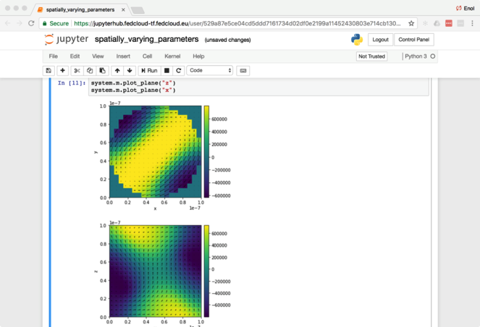
Status
Catch-all instance is available for production users
User has to register in Check-in at the first login
Deployed on INFN-CATANIA-STACK and CESGA cloud sites
Community-specific deployments
E.g. for AGINFRA+ community
E.g. for training (deployed on CESNET cloud)
Explore Binder technology

Slide 14


“Integrating EGI Notebooks with EGI DataHub”
“EOSC-hub Data Platforms for data processing and solutions for publishing and archiving scientific data (PART II)”
During the EOSC-hub week, 12 Friday at 11:00 – 12:30 ⬅
Room: Cracow I+II

Slide 15
What do we want to do?
Several of the use cases in EOSC-hub will enable scientific end-users to perform data analysis experiments on large volumes of data, by exploiting a PID-enabled, server-side, and parallel approach.
Users expect easy to use interfaces like Jupyter Notebooks for interacting with the system.
Producing reusable results following FAIR guidelines
Findability, Accessibility, Interoperability, and Reusability.

Slide 16
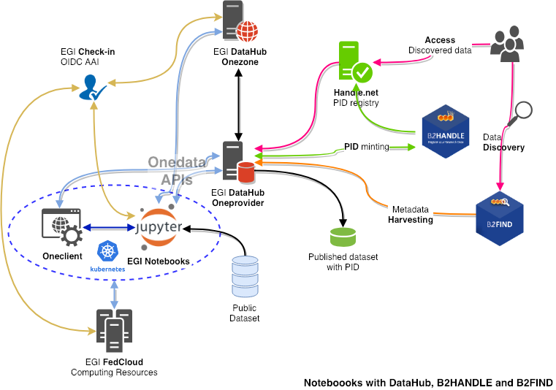

How?
Analysis
Notebooks / JupyterLab
FedCloud resources
Data management
DataHub / Onedata
Space
Onezone
Oneprovider
Oneclient
AAI (OIDC)
Check-in
PID management
B2HANDLE
Handle.net
Cataloguing and discovery
B2FIND
Notes:
A User goes to a Jupyter notebooks service to run an interactive analysis of open data
Notebooks is deployed on a Kubernetes cluster running on EGI FedCloud resources
DataHub used for Data Management
Onedata concepts and components
Space: virtual volume where users organize their data. A space is supported by one or multiple Oneproviders.
Onezone: the federation and authentication service, user for AAI, management and web access.
Oneprovider: a data management component deploy in data centres to expose data and manage transfers
Oneclient: a client application allowing to mount a space locally
Management of publication with PID
Exposition of dataset using OAI-PMH
PID generation by B2HANDLE using Handle.net
DataHub OAI-PMH endpoint is harvested and indexed by B2FIND and can be discovered
Check-in for handling user authentication and authorisation to services with federated AAI
Implementation of AARC’s blueprint
FAIR
Findability: B2FIND, B2HANDLE and Handle.net
Accessibility: Oneprovider
Interoperability: APIs, standards (OAI-PMH)
Reproducibility: Notebooks, Oneprovider

Slide 17
Integrating EGI Notebooks with EUDAT B2DROP

Slide 18
B2DROP
B2DROP offers online storage for researchers
Researchers can collaborate with others and work together on the data.
The data can be shared with external collaborators (B2DROP users or not)
The data can be shared with other platforms, which support the open cloud mesh.
Based on owncloud
Exposes webdav interface for accessing files

Slide 19
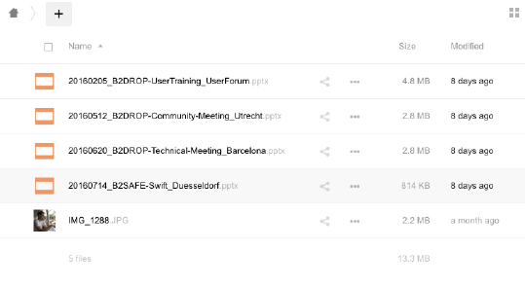

Integration with B2DROP
My_folder
In synch

Slide 20

Produce reproducible Open Science with Binder, Zenodo and EGI Notebooks
Slide decks/material at: https://documents.egi.eu/document/3442

Slide 21
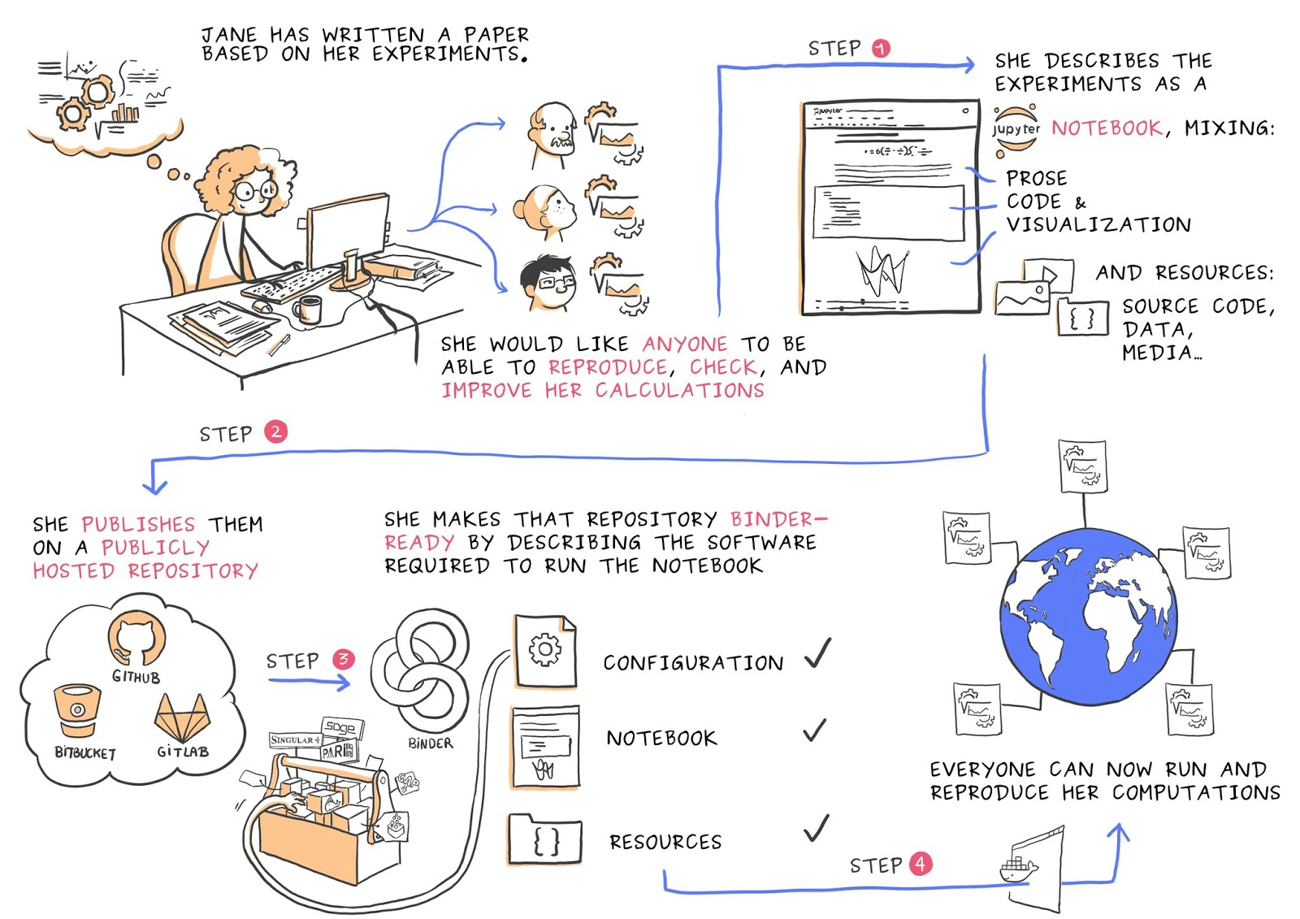
How to make reproducible Open Science
Credit: Juliette Taka https://twitter.com/JulietteTaka

Slide 22
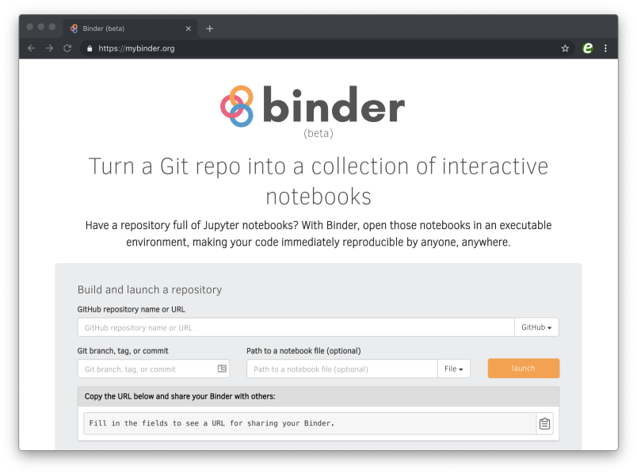


How it works
Binderhub:
Provides an interface to create, and share the sessions
Pulls code from repository
mybinder.org: a public instance of Binderhub hosted on Google Cloud
repo2docker: Creates reproducible containers from repositories
jupyterhub: Generates user sessions that serve these containers
Kubernetes: manages the computing infrastructure

Slide 23
The Open Science story: the current step
EGI Notebooks services
MyBinder.org
Download ipynb file
Execute
Re-execute
Create repository
Upload ipynb file
Add requirements.txt
GitHub
Your repository
Provide GitHub project reference
Your laptop
Specify GitHub repo
Generate DOI
Zenodo
Data repository
Obtain GitHub project reference
Fellow researchers
Discover Notebook (use DOI)
Journal paper
DOI

Slide 24
An Open Science story: The next step
EGI Notebooks and Binder service
DataHub
B2DROP
Etc.
Distributed big data
Download ipynb file
Execute
Create repository
Upload ipynb file
Add requirements.txt
GitHub
Provide GitHub project reference
Your repository
Your laptop
Generate DOI
Specify GitHub repo
Generate DOI
Zenodo
Data repository
Obtain GitHub project reference
Fellow researchers
Discover Notebook (use DOI)
Journal paper
DOI

Slide 25
Upcoming events
“EOSC-hub Data Platforms for data processing and solutions for publishing and archiving scientific data (PART II)”
During the EOSC-hub week, 12 Friday at 11:00 – 12:30 ⬅
Room: Cracow I+II
JupyterHub Developments training @ EGI Conference 2019, 06-08 May 2019, Amsterdam
Agenda: https://indico.egi.eu/indico/event/4431/session/4/?slotId=0#20190506

Slide 26
References
Onedata
https://onedata.org
EGI DataHub
https://datahub.egi.eu - http://egi-datahub.readthedocs.io/
EGI Notebooks
https://www.egi.eu/services/notebooks/ - https://notebooks.egi.eu/
EGI Check-in
https://www.egi.eu/services/check-in/ - https://wiki.egi.eu/wiki/AAI
B2FIND
https://eudat.eu/services/b2find - http://eudat7-ingest.dkrz.de/
B2HANDLE
https://eudat.eu/services/b2handle - https://hdl.grnet.gr:8001/api/handles

